Slide 1
Surround Sound

Slide 2
Disable surround sound to enable pure stereo
28-03-2025

Slide 3
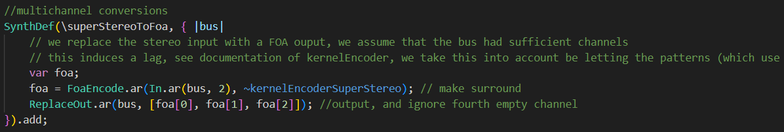
Current situation 28-03
Currently all DJ deck outputs are transformed by superStereoToFOA to convert the stereo 2 channel signal to FOA 3 channel;
Drawbacks
this is done using a kernel algorithm and introduces latency;
We use a matrix method to convert back to stereo (introduces no latency), but hereby we loose part of the sound; namely the sound which is coming from behind

Slide 4
Solution requirements
Goal
Make it possible to switch to pure stereo mode, without latency increase due to kernel FOA transformation
Conditions
Should also allow for the future case where songs will be converted in front from stereo to surroung, and the deck players themselves will be surround
3 channel bus structure should stay the same

Slide 5
Suggested solutions
Keep the original stereo signal on the 3 channel bus;
so disable the stereoToFOA transformation;
Disable FOA to speaker transformation
Allow for different speaker transfomations; to allow for different speaker configurations
Convert from stereo to FOA by matrix transformation; such that transformation is exactly symmetric with FOA to stereo transformation
Change FOA to speaker transformation to FOA to stereo transformation;
Benefit
- Do not waste computer power on unnecessary matrix transformations
Benefit:
- Keep all surround/FOA architecture intact, such as panning and pushing

Slide 6
Implication
Despite the solution we choose, we will break the (unused) feature that the sampler and tracks are in sync; because this was ensured by matching the kernel induced latency with the language-server latency

Slide 7
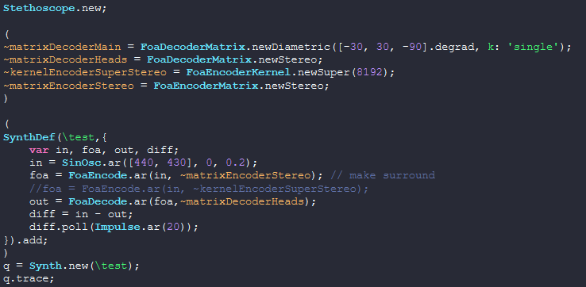
Test stereo to FOA and back by matrix
After transforming the signal forward and backward, it is close to identical to the original signal;
Usable!
pureStereo.scd
The following does not work because singular:
~matrixDecoderMain = FoaDecoderMatrix.newDiametric([-pi/2], k: 'single');

